Slide 1


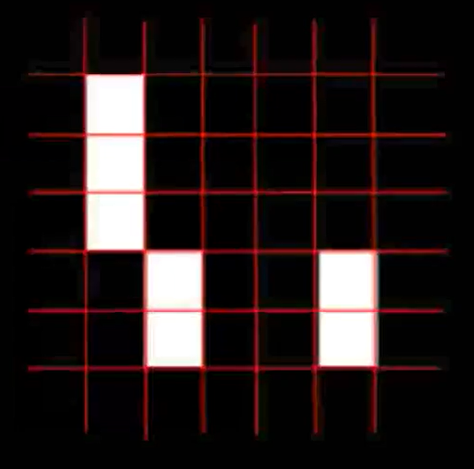
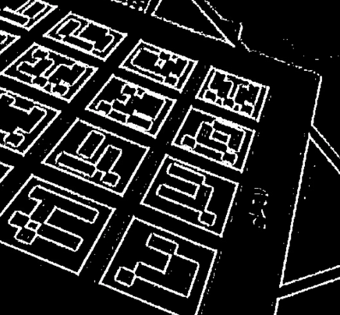
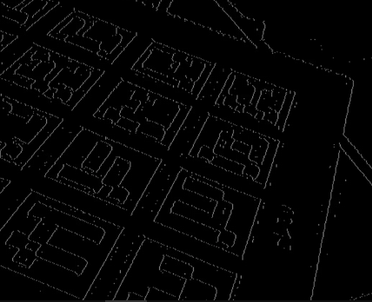
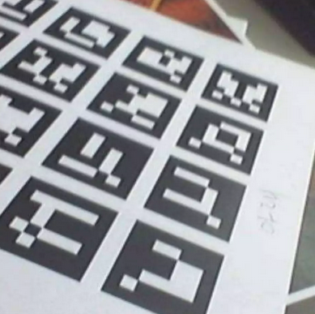
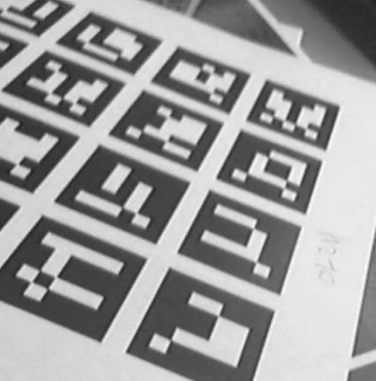

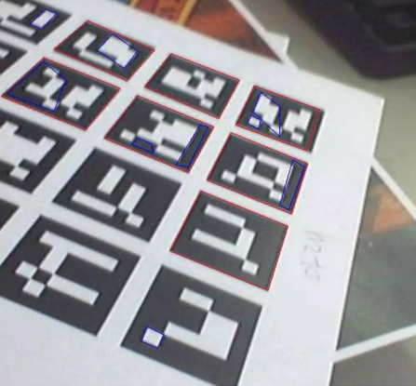
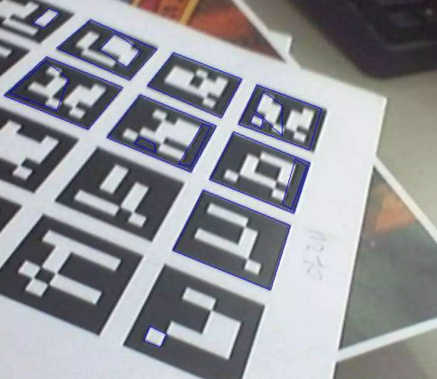
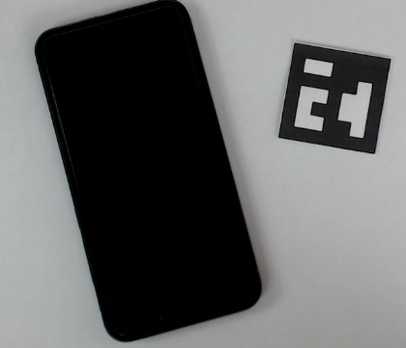
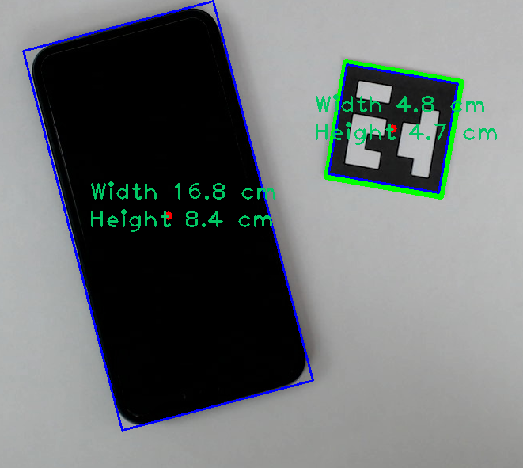
Course Name: Digital image processing Lab
Course Code: CSE-5211
Project Title: Object Size Measurement Using Aruco Marker
What is Aruco Marker?
How Aruco Marker Works
How marker detection algorithm works
Test Image
Convert into gray
Adaptive threshold
Find Contours
7 X 7
Application of Aruco Marker
Marker ID: 0011000000
1st | 2nd | 3rd | 4th | 5th
1 | 0 | 0 | 0 | 0
0 | 1 | 1 | 1 | 0
1 | 0 | 0 | 0 | 0
1 | 0 | 0 | 0 | 0
1 | 0 | 0 | 0 | 0
Calculate Markers ID
Find Valid markers
Find Rectangles
Object size measurement
AR vision mapping
Robotic Control
Drone Navigation system
Distance Estimation
3D object mapping
ID in decimal: 192
How to measure the size of an object
Place an Object with aruco marker
Capture footage and detect marker
Compute centroid of marker along with known 2D location in the plane and compute homography
Detect the object and apply homography to get 2D plane coordinates
Object Size Measurement
Presented to : Md. Mynoddin, Assistant Professor, CSE, RMSTU
Team Member: MD. SHIHABUL KOBIR Reg.No.: 2017-14-15
HARUNAR RASHID Reg.No.: 2016-13-22

